Slide 1

Accommodations office
Disability Support System Proposal

Slide 2

Introduction
Many disabled students face difficulties throughout their academic journey.
This Accommodation Platform is intended to provide equal access to all students.
By achieving full accessibility for them, this will reduce social & participation barriers between other students

Slide 3
Mission
To provide tailored support, reasonable accommodations, and advocacy, ensuring that students with disabilities have equitable access to all aspects of university life and a supportive learning experience.

Slide 4
Vision
To foster an inclusive and accessible educational environment where students of all abilities can fully participate, excel, and achieve their academic potential.

Slide 5
Objectives
Ensure compliance with national and international disability education laws and institutional policies.
Develop and implement policies and regulations that support equitable access and inclusion for students with disabilities in the university.
Foster disability awareness and inclusion through training programs for faculty, staff, and students.

Slide 6
Objectives
Offer comprehensive support services, including counseling, academic assistance, and assistive technology.
Promote an inclusive curriculum by advocating for adaptive teaching strategies that address diverse learning needs.
Enhance campus accessibility by providing necessary accommodations in both physical and digital environments

Slide 7
Students
Faculty staff
Admin staff
Intended users
To submit disability-related forms and access personalized learning support plans.
To submit disability-related forms and access personalized learning support plans.
To review submissions, facilitate interviews, and manage the approval process for learning support plans.

Slide 8
Director of the department
Disability Advisors/ Accessibility Coordinator
Administrative Staff/officers
Assistive Technology Specialist
Department Structure
Leads departmental operations, policy implementation, and inter-departmental collaboration.
Collaborate with students & professors to develop personalized support plans.
Manages appointments, documentation, and departmental communication.
Advises on and trains students in adaptive technology use.

Slide 9
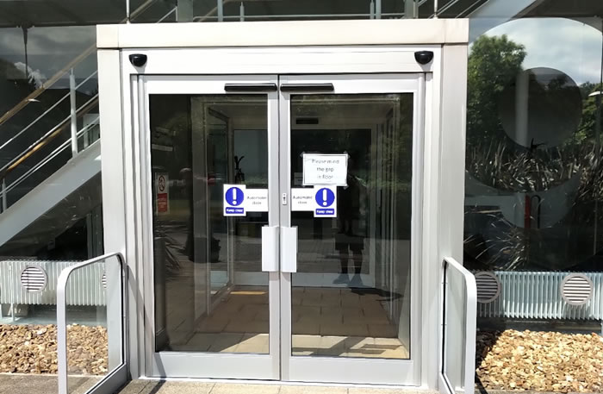
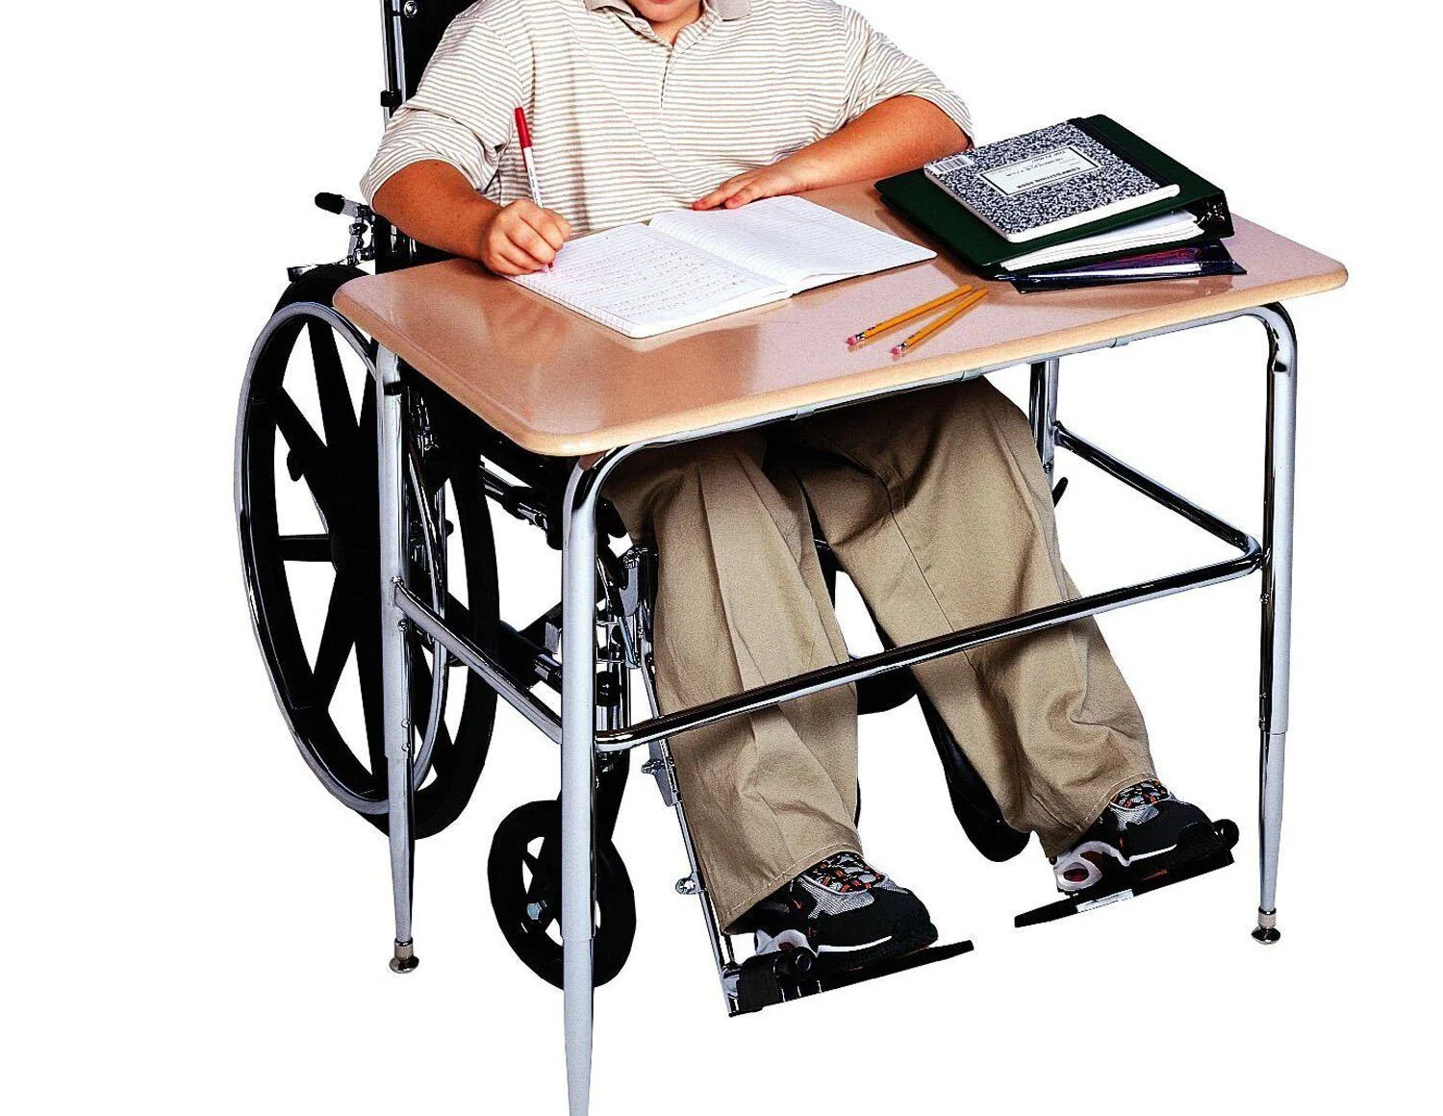
Disability Spectrum
Disabilities can vary and be physical, mental, or visible.
To ensure equitable access, some straightforward adjustments can be done:
Installing Automatic
Doors
Desks with suitable heights

Slide 10

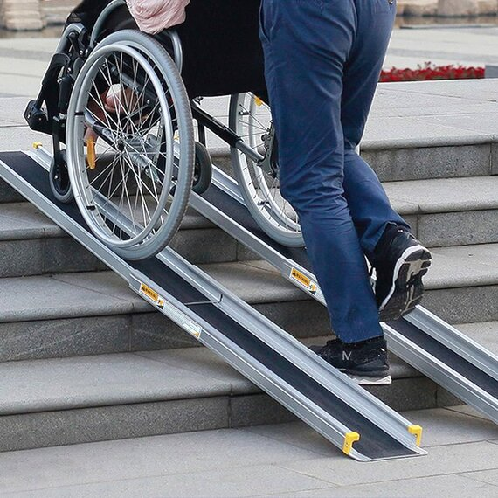
Accessibility Initiatives
Accessible Digital Resources.
Assistive Technologies: Screen readers, voice recognition software, FM systems, and adaptive tools.
Campus Accessibility: Installation of ramps, elevators, and tactile pathways

Slide 11
Support Services
Academic support: Personalized Learning Plans, Academic Assistance & Peer Support Programs.
Mental Health Support: Regular counseling and support groups.
Career Services: Tailored career guidance and internship opportunities.

Slide 12
Scope of supported disabilities

Slide 13

Attention Deficit Disorder (ADD)/Attention Deficit Hyperactivity Disorder (ADHD):
These conditions can notably impact academic performance, causing difficulties with time management, organization, attention to detail, distractibility in the classroom.

Slide 14
Learning Disabilities
These disabilities often manifest as challenges in reading comprehension, solving mathematical problems, written and oral expression, listening skills, spelling, punctuation, grammar, visual and auditory processing, comprehension, and abstract reasoning.

Slide 15

Chronic Health Conditions
long-term health issues such as diabetes, epilepsy, multiple sclerosis, muscular dystrophy, renal disease or failure, and cancer, which may necessitate specific accommodations to support affected students.

Slide 16

Visual Impairment
Students with visual impairments may encounter difficulties in reading, writing, note-taking, responding to visual aids, and navigating the campus environment.

Slide 17

Hearing Impairment
Affect a student's ability to listen to and comprehend lecture content, take effective notes, engage in group activities, and participate in class discussions.

Slide 18
Physical Disabilities
These may limit a student's mobility on campus and within the classroom, hinder note taking during lectures, and restrict access to appropriate seating arrangements.

Slide 19
Psychological Disorders
Conditions like depression, anxiety, and schizophrenia are recognized when they impair cognitive functioning and adversely impact a student’s overall performance.

Slide 20

Temporary Disabilities
ESLSCA University recognizes temporary disabilities as impairments expected to last less than six months.

Slide 21
Hidden Disabilities Sunflower Scheme
The Hidden Disabilities Sunflower scheme provides a discreet way for individuals with hidden disabilities to signal that they may require additional support and understanding in various environments. (Autism spectrum disorders, ADHD, and learning disabilities like dyslexia).
Increased Awareness
Discreet Communication
Wearing the lanyard alerts staff and peers to the potential challenges you may face, fostering a more supportive and accommodating environment.
It serves as a non-verbal cue, allowing individuals to indicate their need for extra patience, understanding, or assistance without feeling the need to explain their situation.

Slide 22
The Included in the Academic Accommodation Plan

Slide 23
Academic Accommodation Plan
Receiving handouts and lecture presentations in advance. Modifying course materials.
Class participation accommodation.
Assignment format, number of assignments, weight of assignments and deadlines.

Slide 24
Academic Accommodation Plan
Permission to make personal recordings of teaching sessions.
One to one session with tutors.
Online sessions.
Oral presentation accommodation.

Slide 25
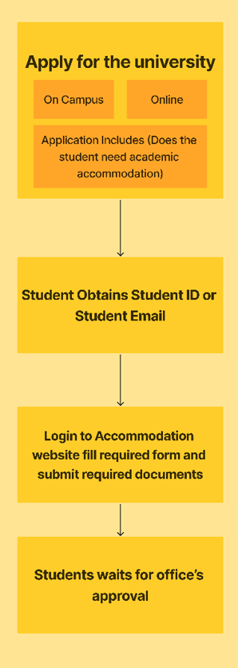
Application Process (Student Side)

Slide 26
Supporting documents
Issued by a recognized medical professional or an authorized representative.
Up to date as possible (this is not as vital if it is a long-term or life-long condition).
Must provide a clear clinical or medical diagnosis of a disability that significantly affects daily activities or academic performance.

Slide 27
Supporting documents
Specify whether the disability is long-term (lasting or expected to last at least 12 months).
If the disability is temporary, the document must clearly state its expected duration.
Indicate the impact your disability has on your daily life, particularly your studies.

Slide 28
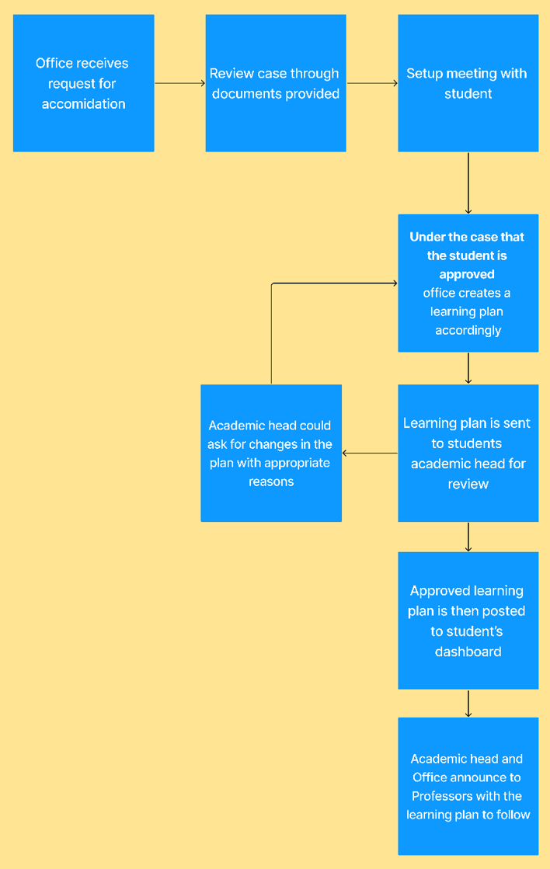
Application Process (Admin Side)

Slide 29
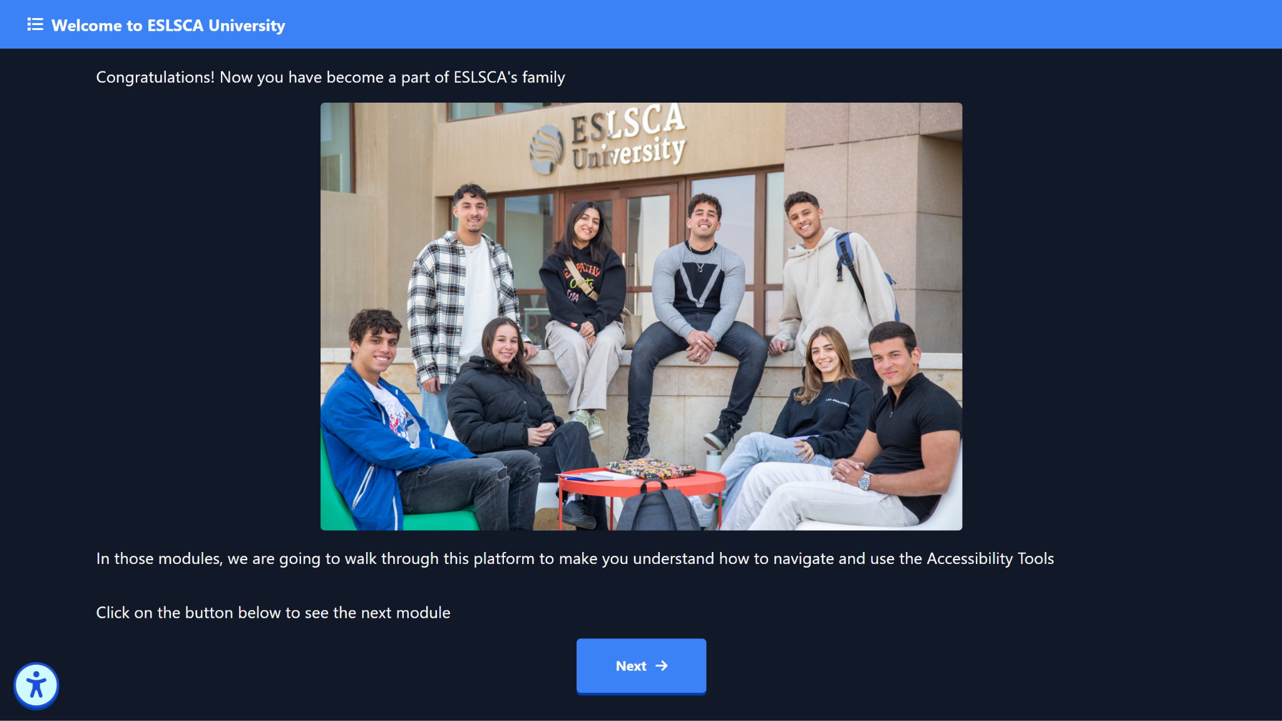
Application Process (Student Side)
Notes:
The student is then introduced to the platform with the student id. The

Slide 30
Challenges Addressed
Simplifying the submission and review process for disability evidence.
Creating tailored academic learning plans to meet diverse disability requirements.
Ensuring seamless communication and integration between stakeholders.

Slide 31
Design and features
Dashboard
Submitting system
A dashboard for managing forms, feedback, and calendars
system for submitting, reviewing, and approving learning support plans.
Seamless integration
Integration with other university systems such as the self-service portal and the university website.

Slide 32
Planned Features
Future integration with additional university systems.
Notifications for users regarding the status of their submissions.
Analytics for tracking and improving the support services.

Slide 33
Future Plans
Expanding the system to include other support services.
Developing a mobile application for improved accessibility and user experience.

Slide 34
Workflow
Form Submission: Students submit the Disability Evidence Form.
Review: Administrative staff review the submission.
Interview: Students are scheduled for an interview with the Accommodation Office.

Slide 35
Workflow
Plan Creation: The Accommodation Office creates a tailored learning support plan based on the specific disability.
Approval: The plan is approved by the relevant department head (ie: BBA, BDT).
Release: The approved plan is shared with the student.

Slide 36


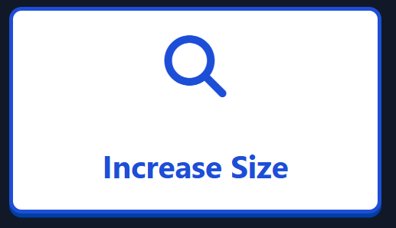


Accessibility Features
The platform follows WCAG Standards such as:
Magnifier tool to help with
readability
Dyslexic font
Indicator bar to help with focus-
reading
Screen reader support for
Students with visual impairment

Slide 37
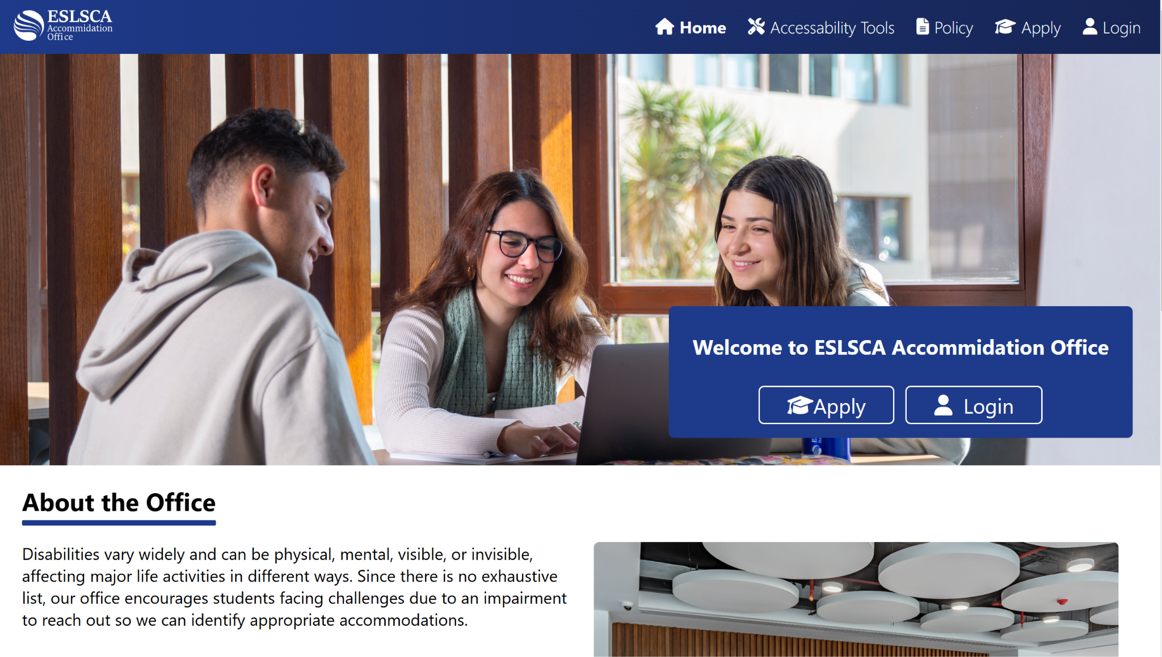

Slide 38
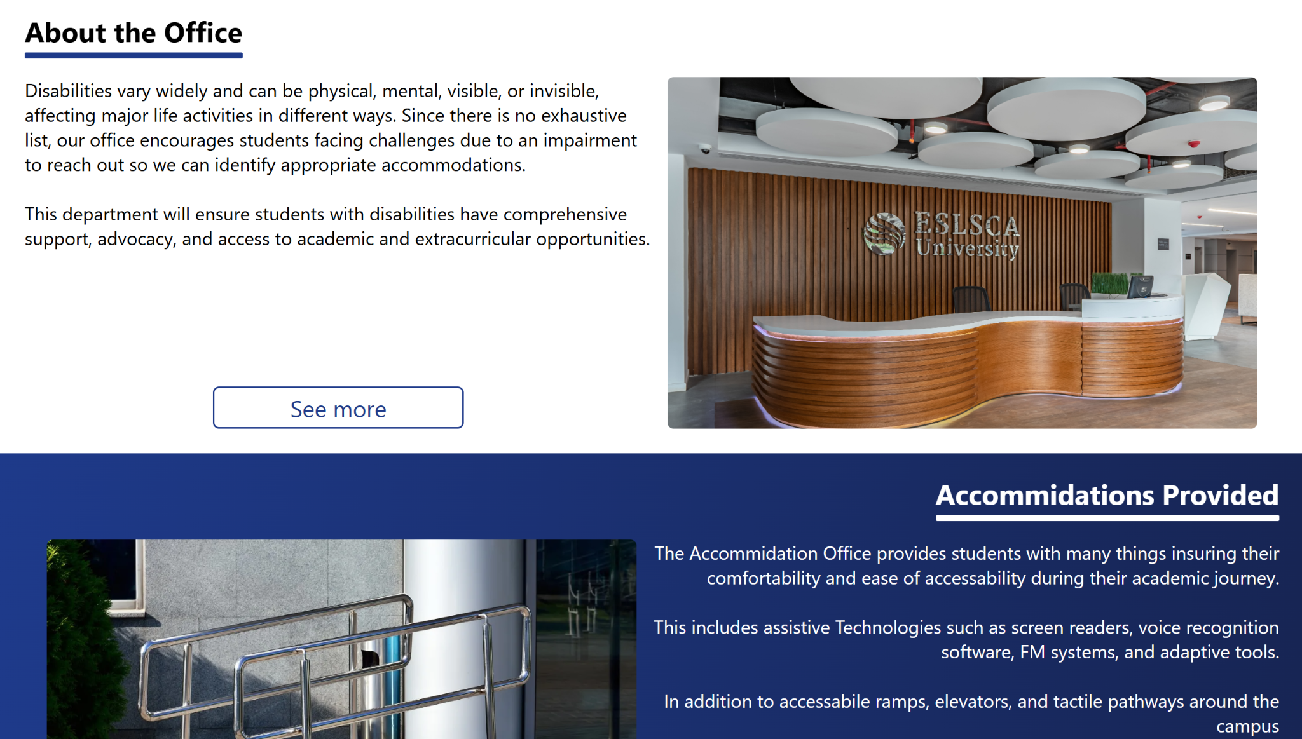

Slide 39
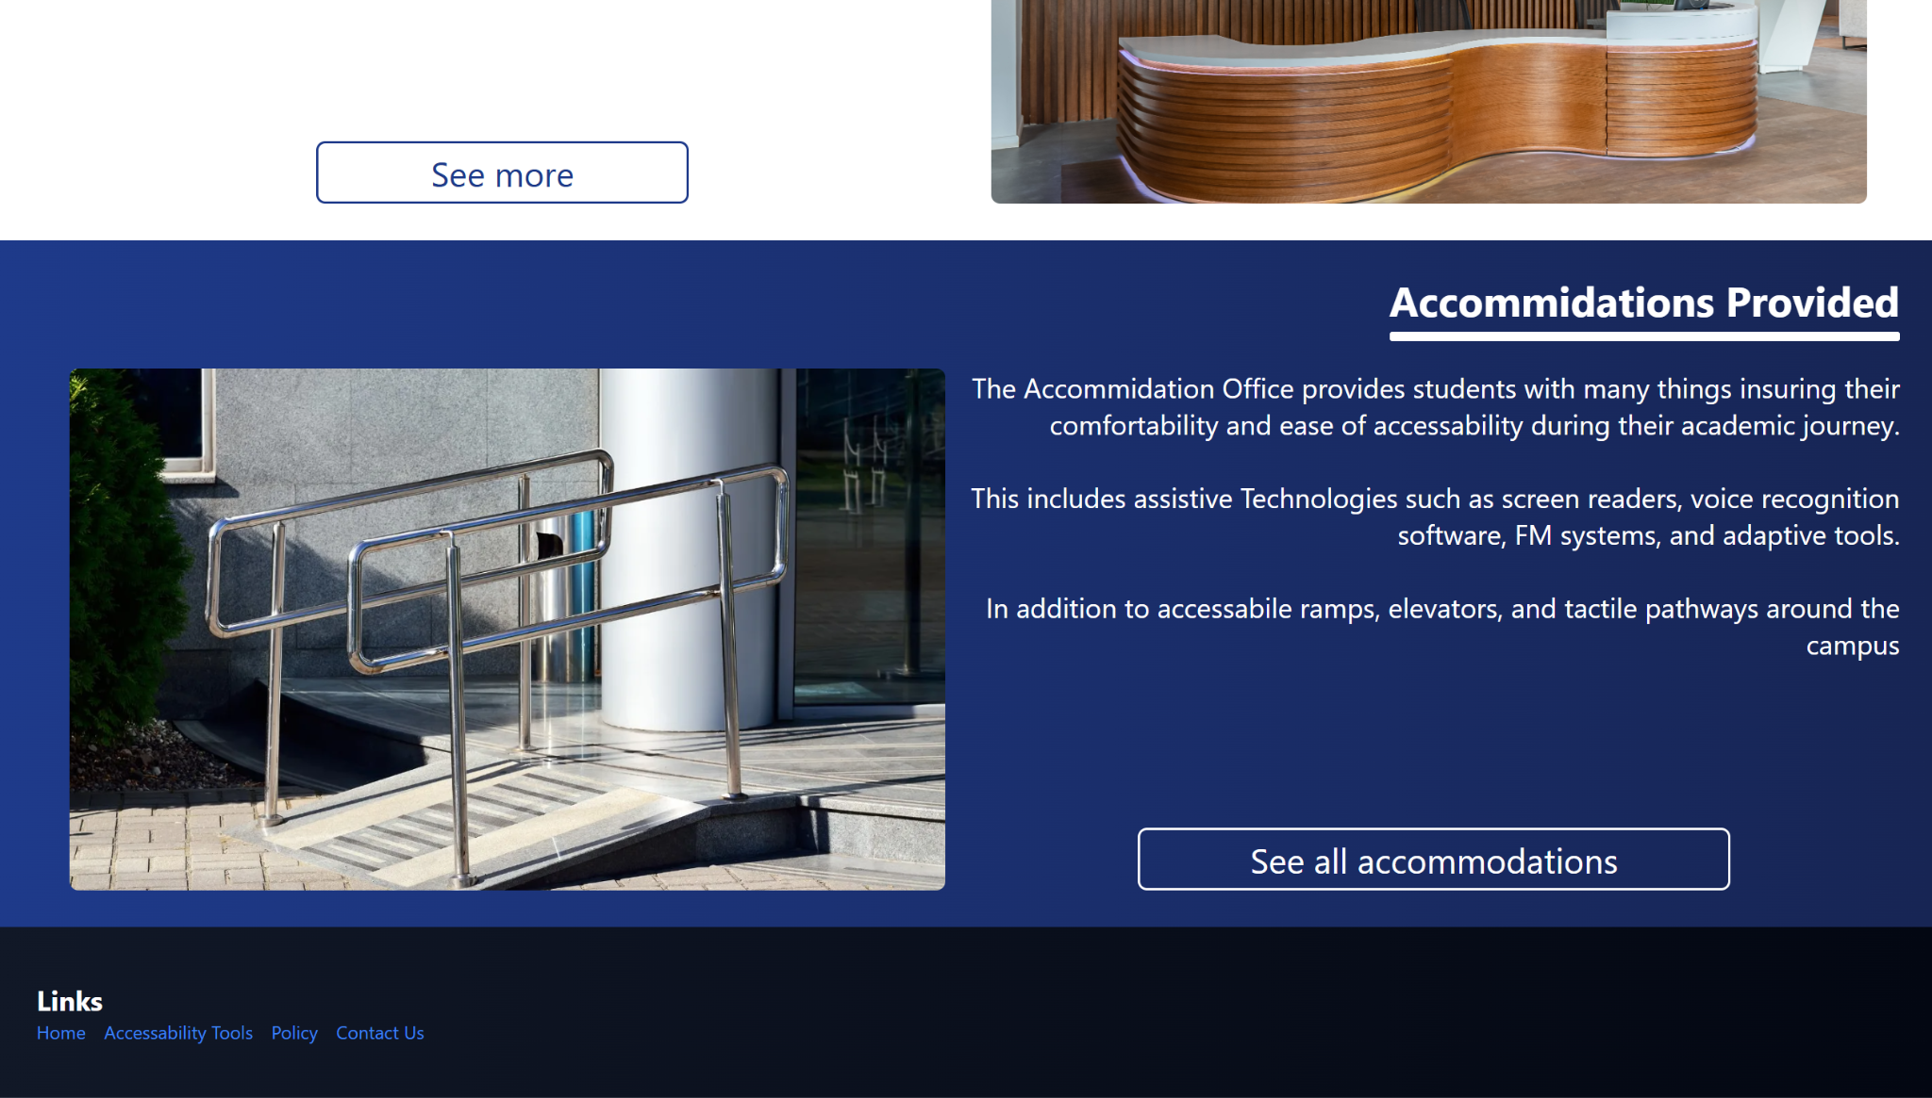

Slide 40
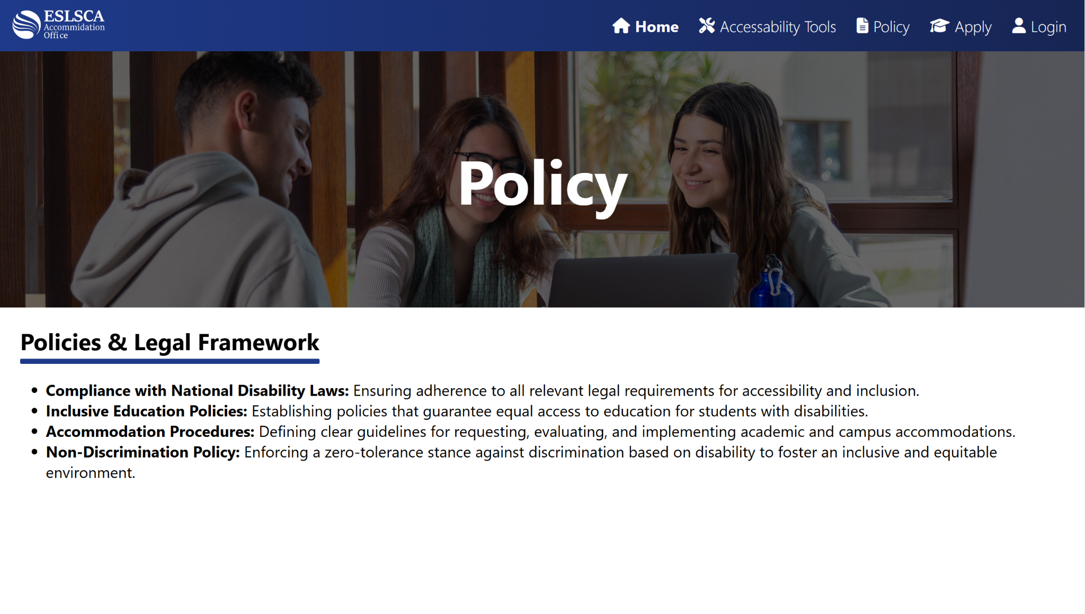

Slide 41
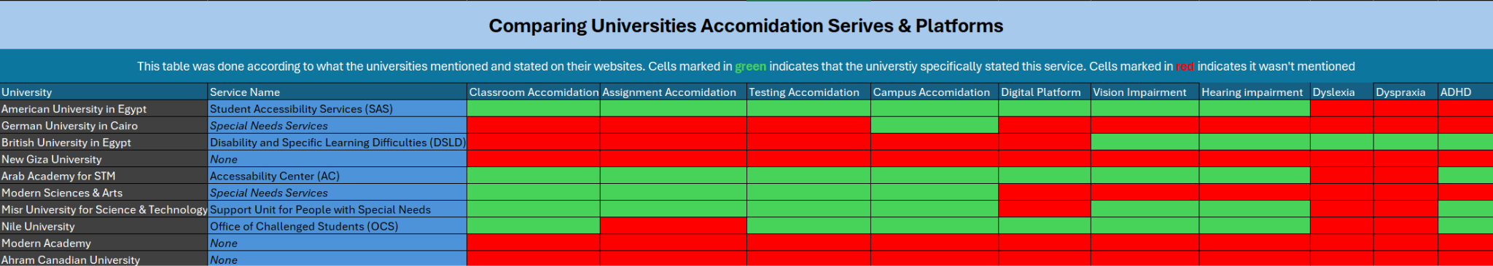
Top universities for disability support:
Arab Academy for STM (Best)
American University in Cairo
Nile University
MUST University
Least universities:
New Giza University - Ahram Canadian University - MSA University

Slide 42
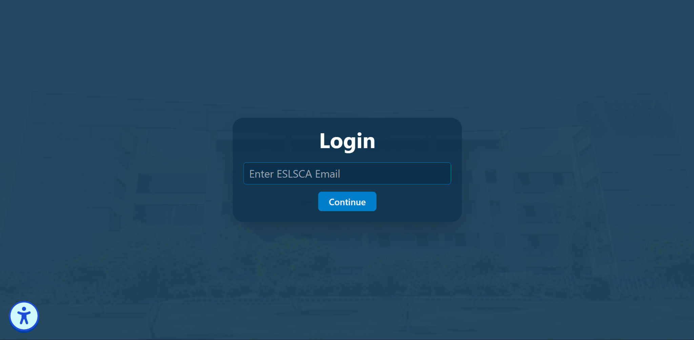

Slide 43
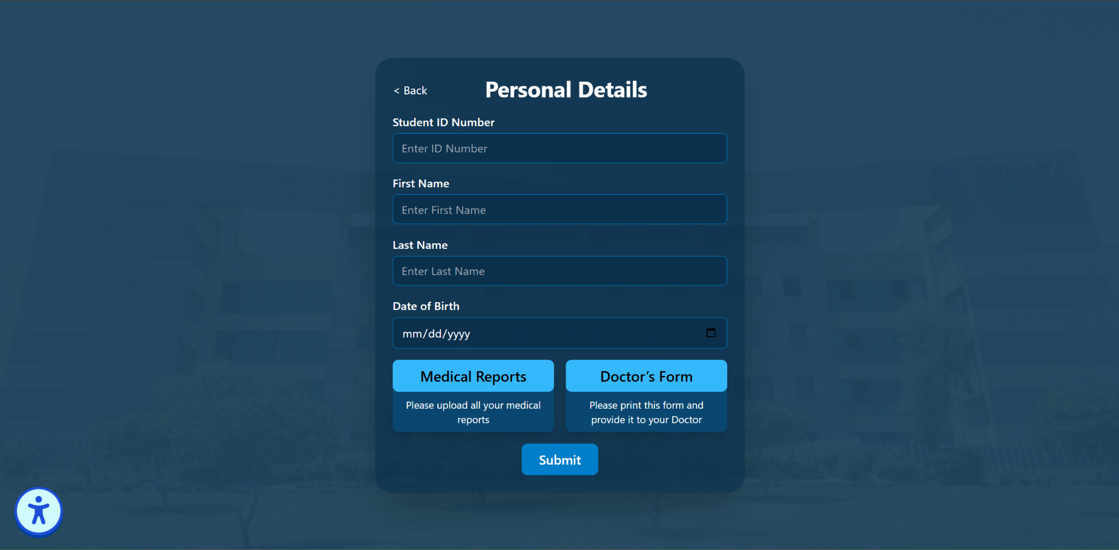

Slide 44
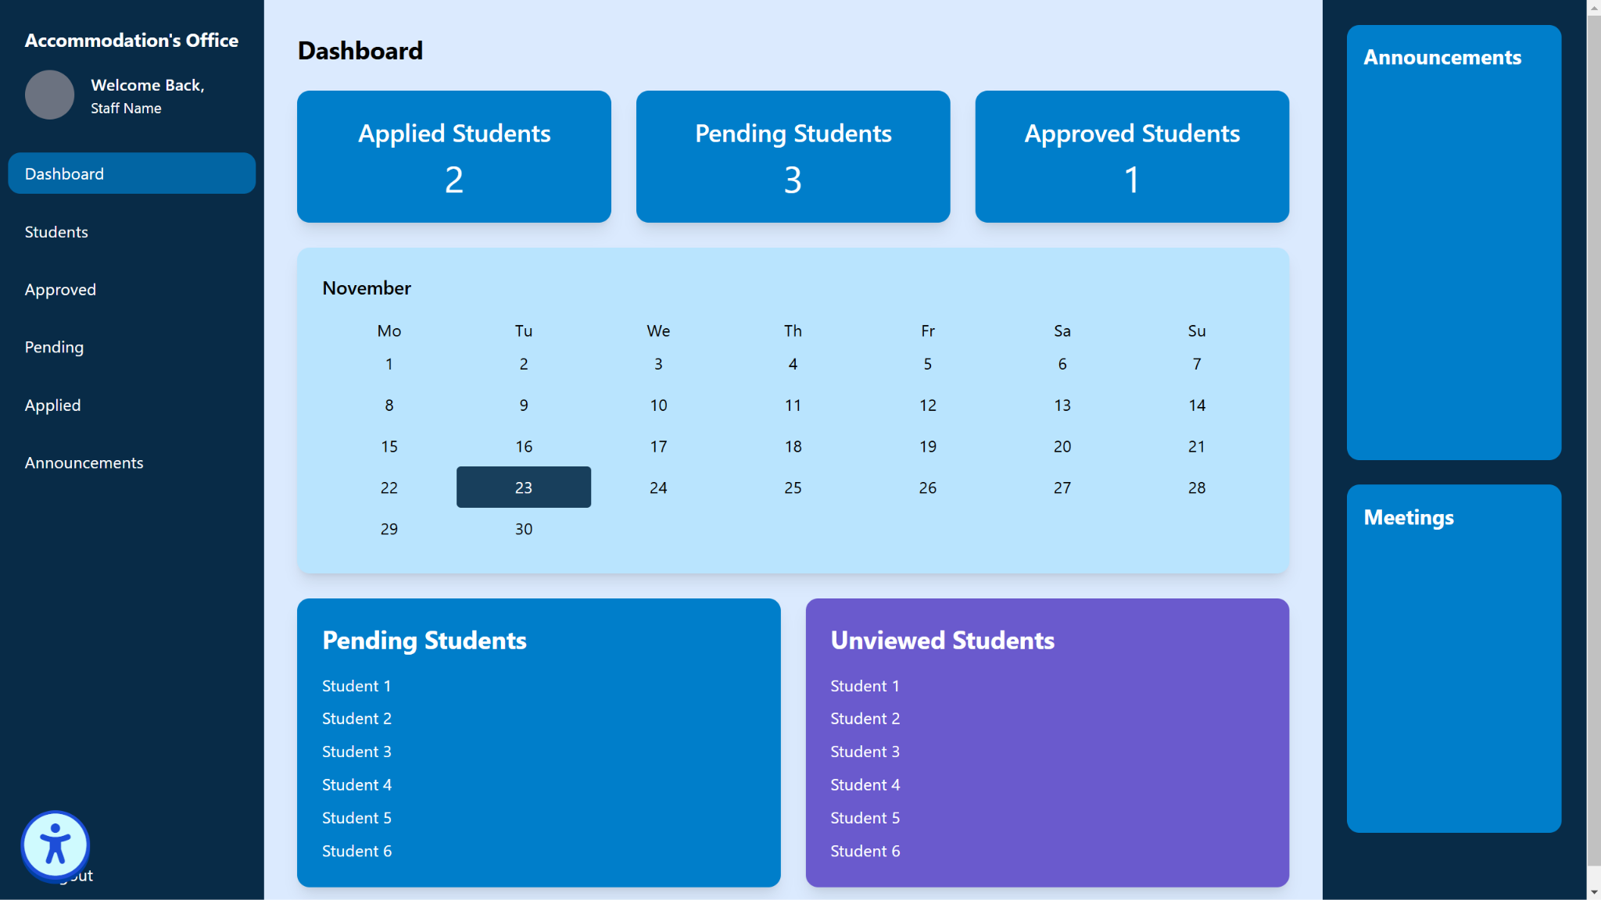

Slide 45
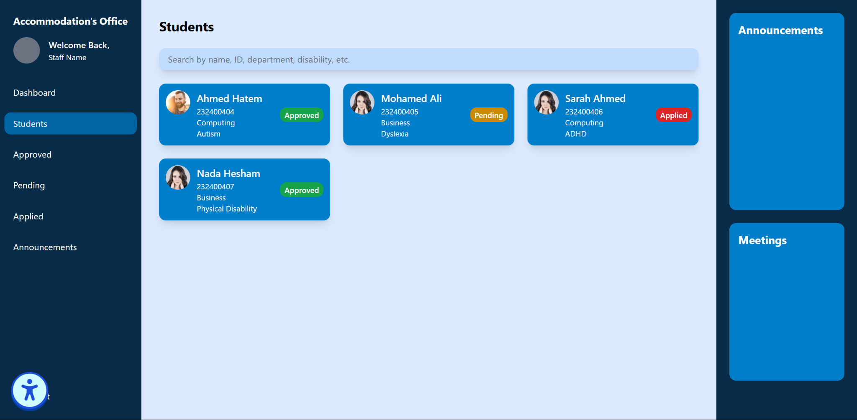

Slide 46
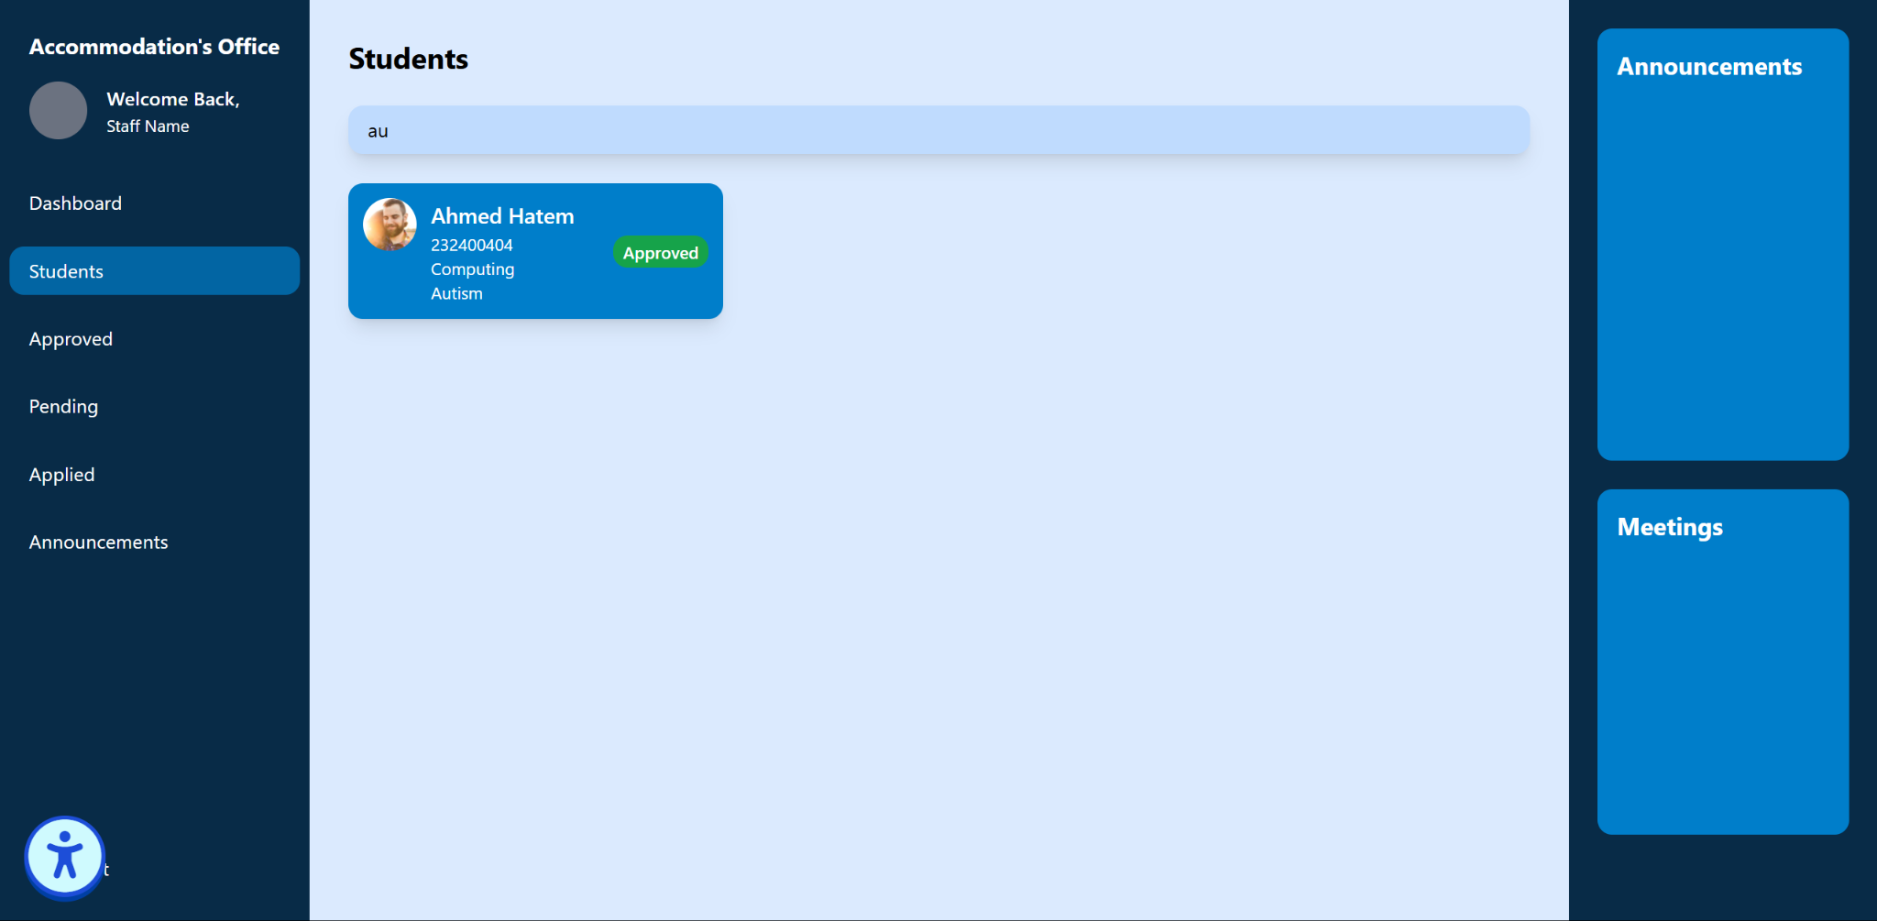

Slide 47
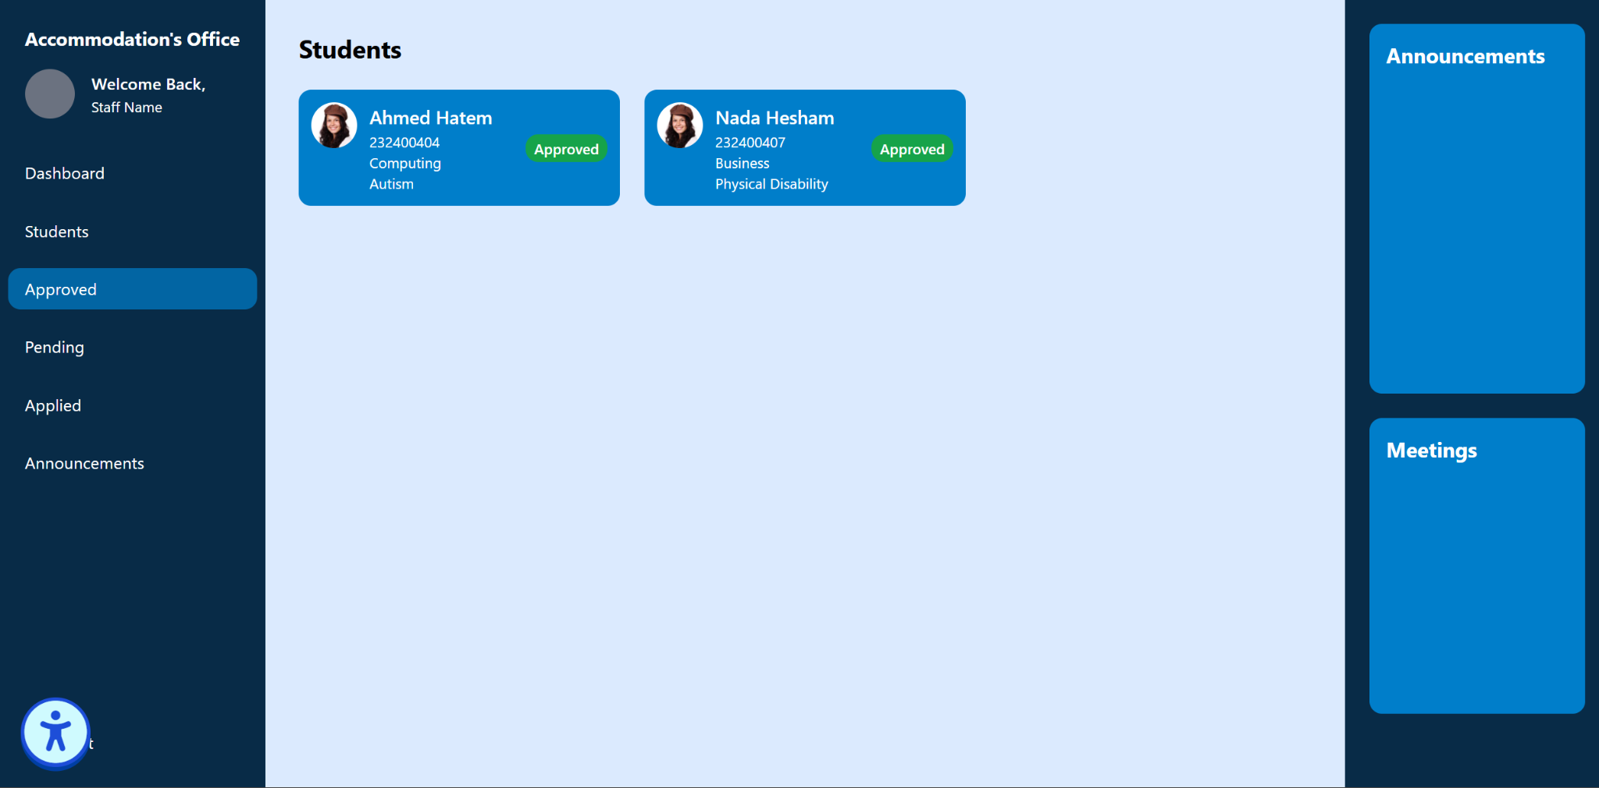

Slide 48
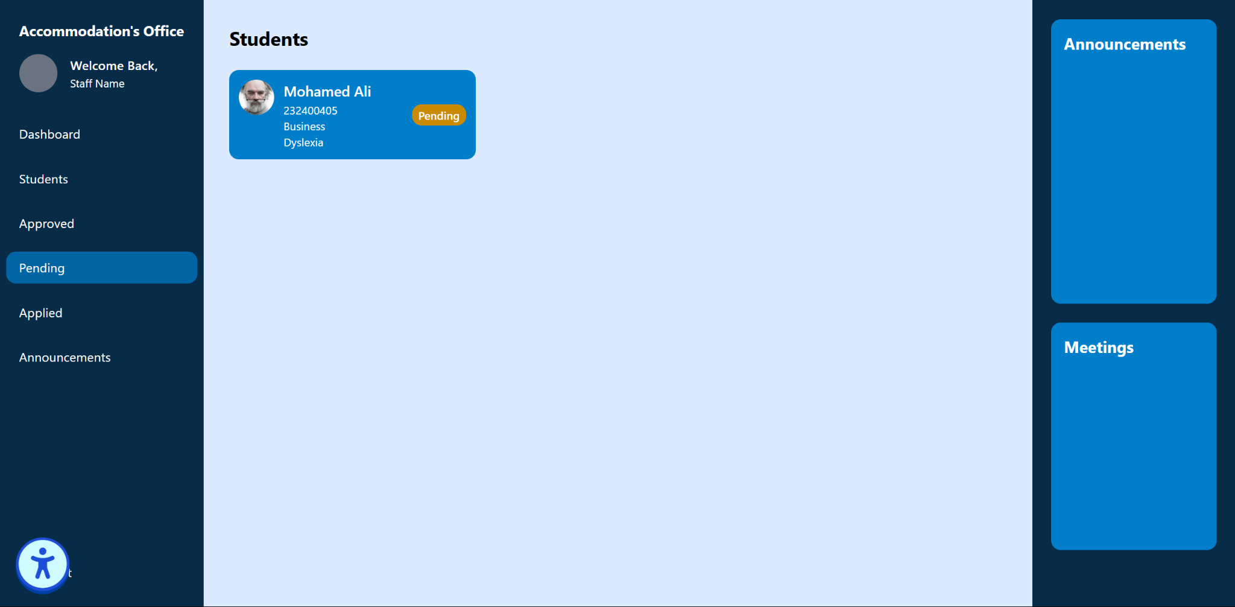

Slide 49
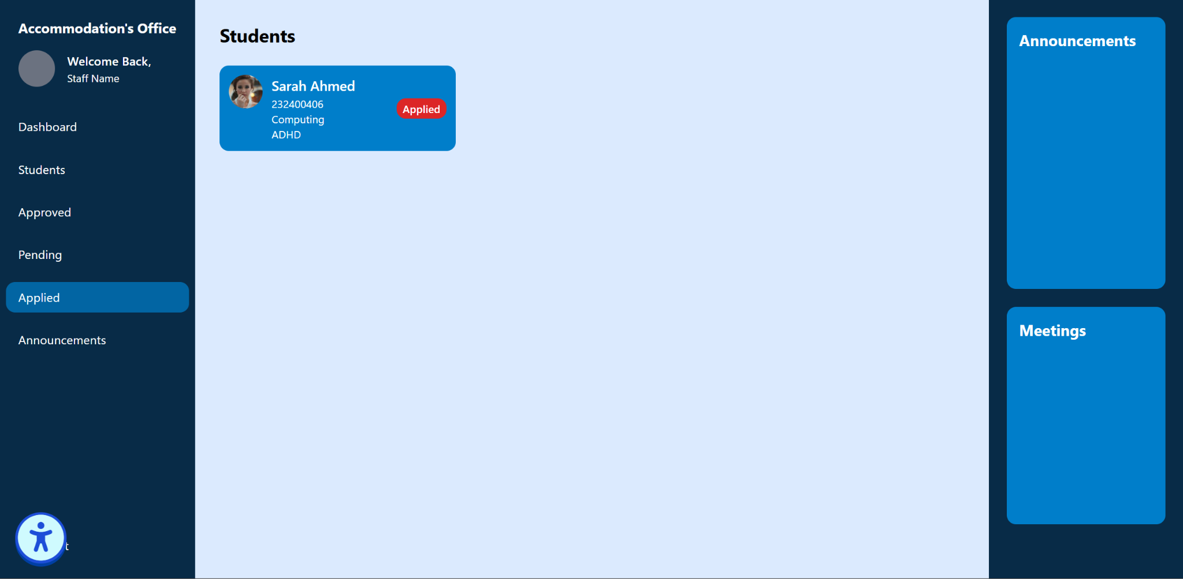

Slide 50
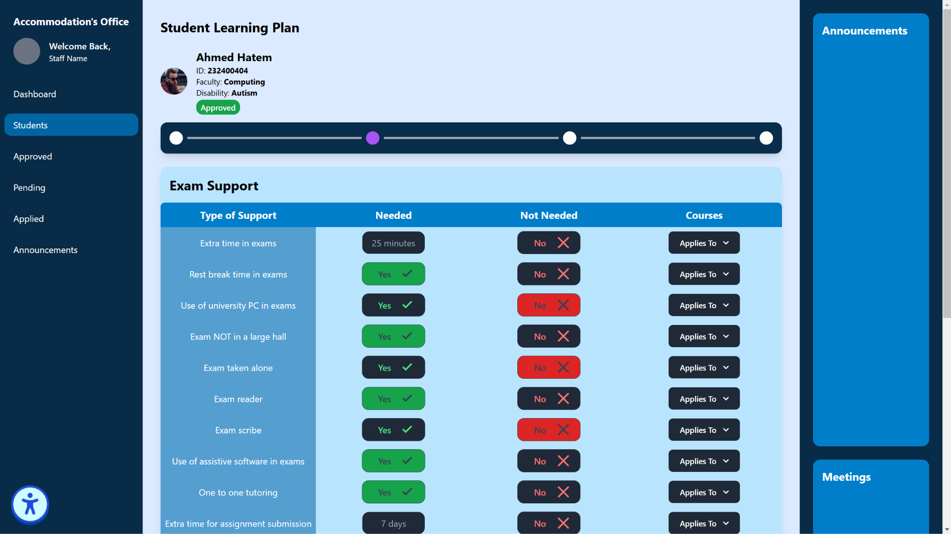

Slide 51
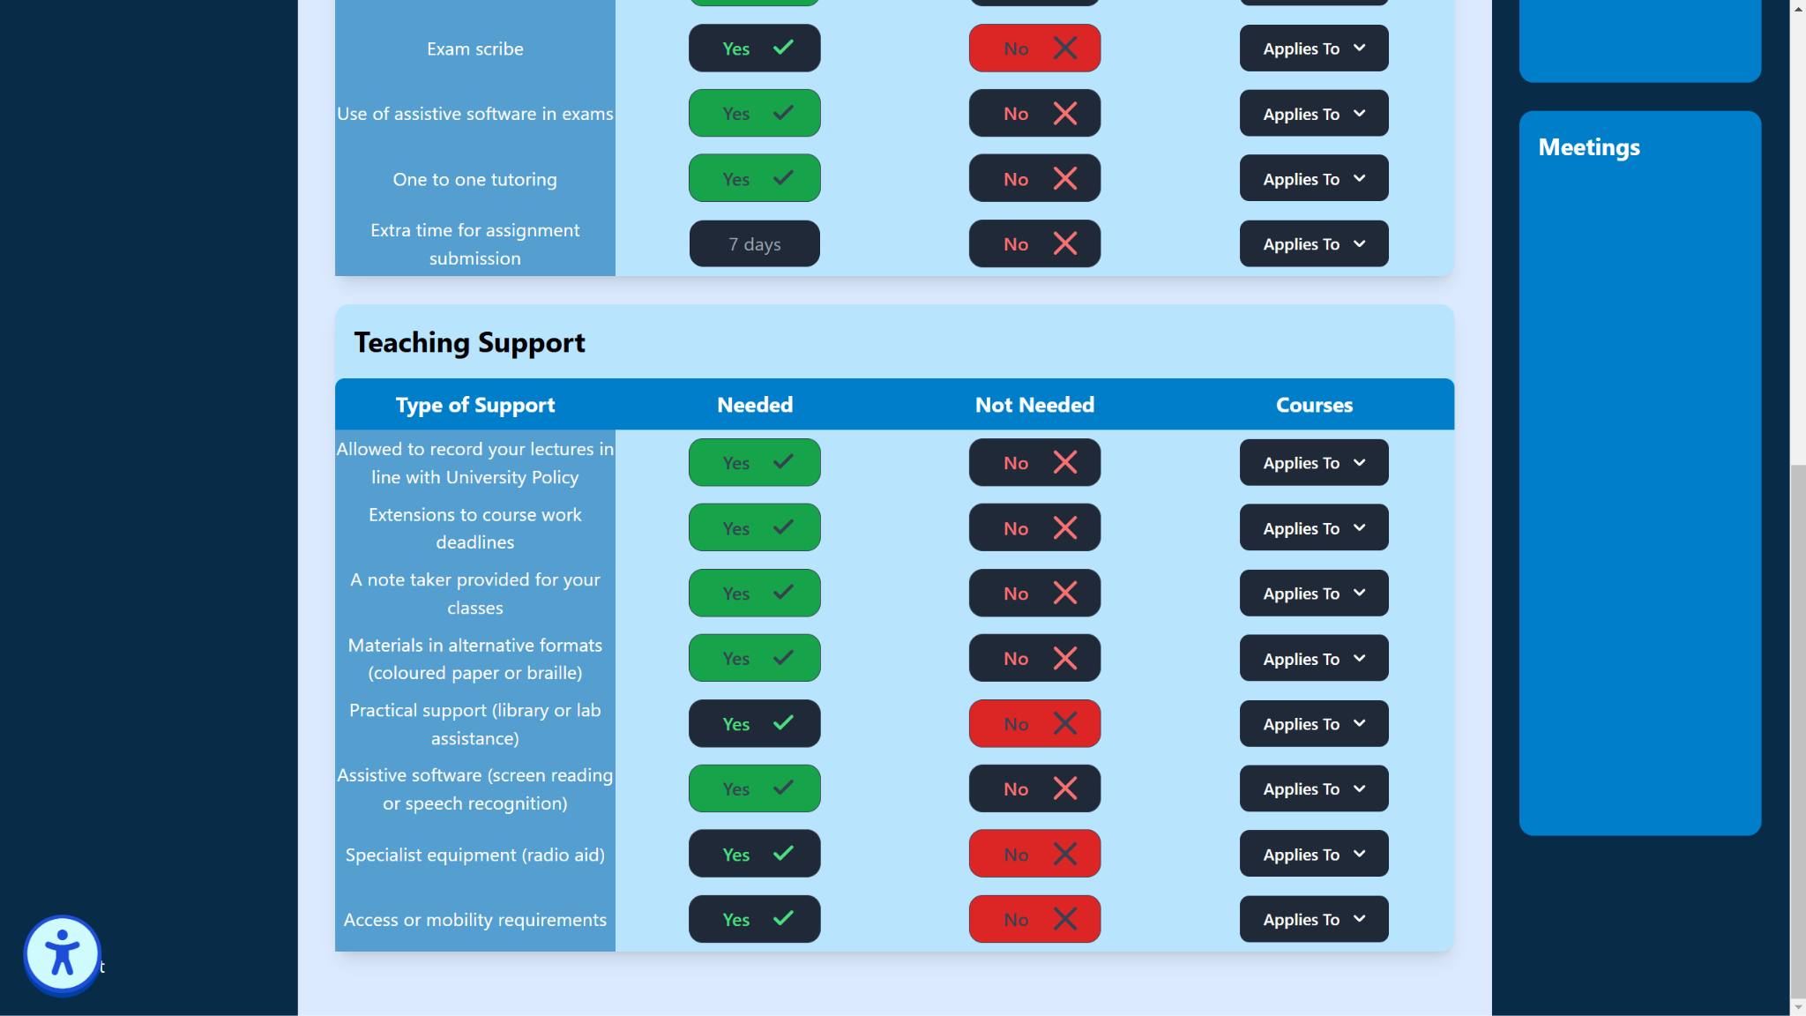

Slide 52
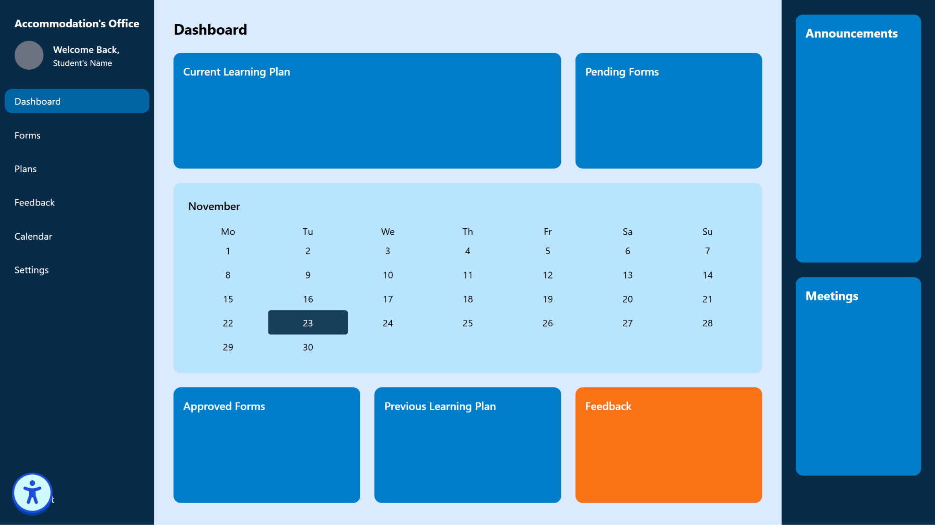

Slide 53
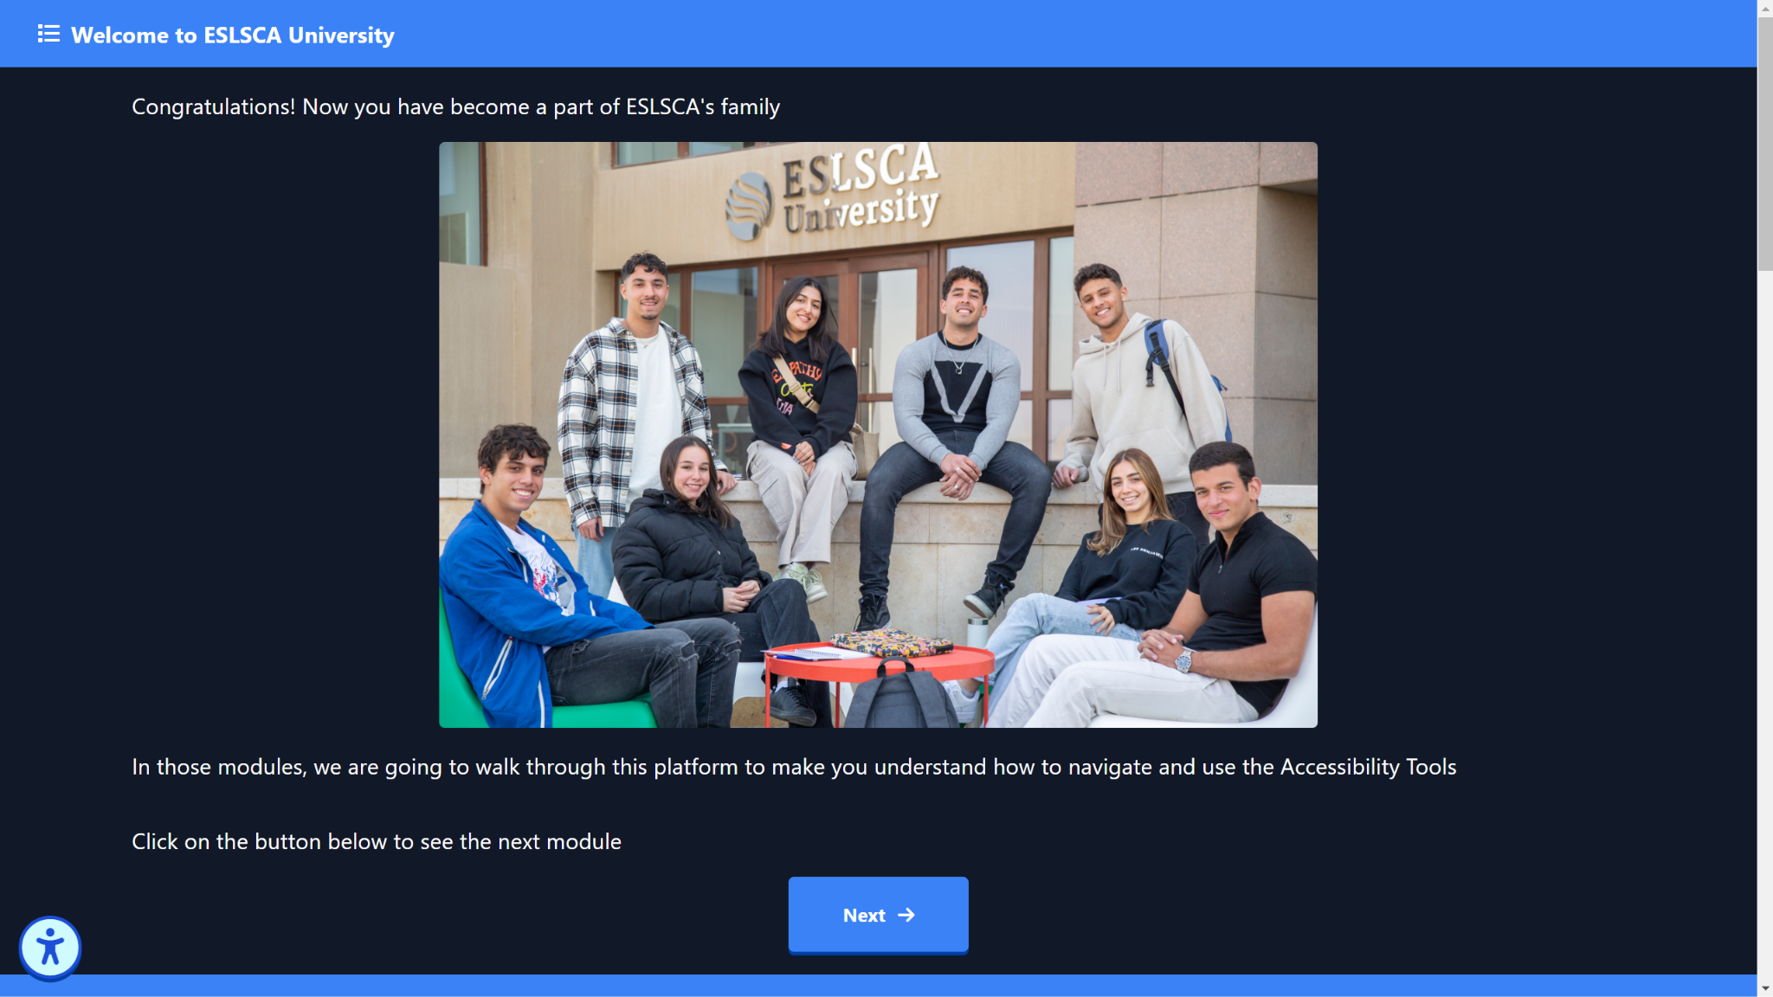
“This is a quote, words full of wisdom that someone important said and that can inspire the reader”
—Someone Famous

Slide 54
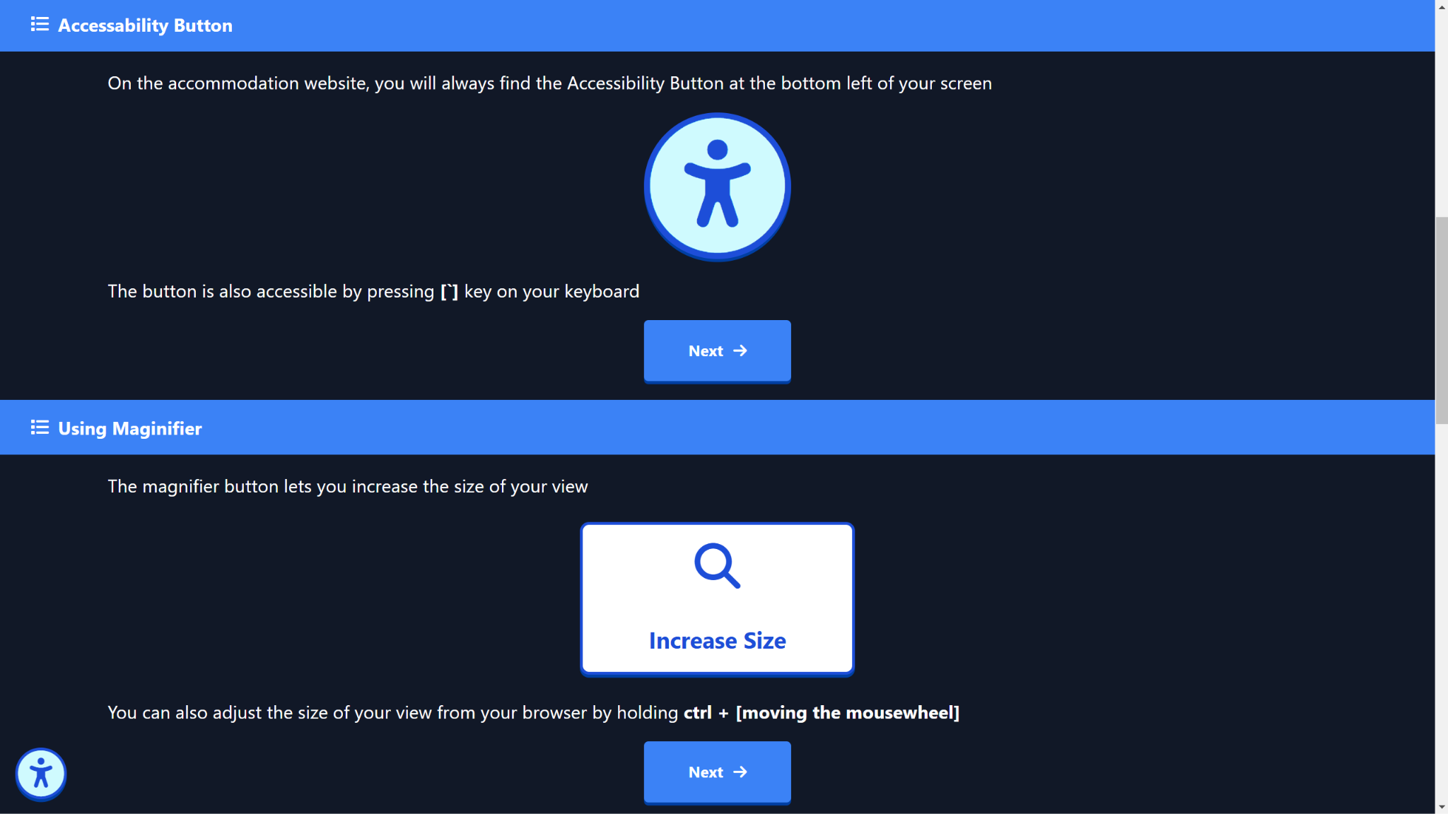

Slide 55
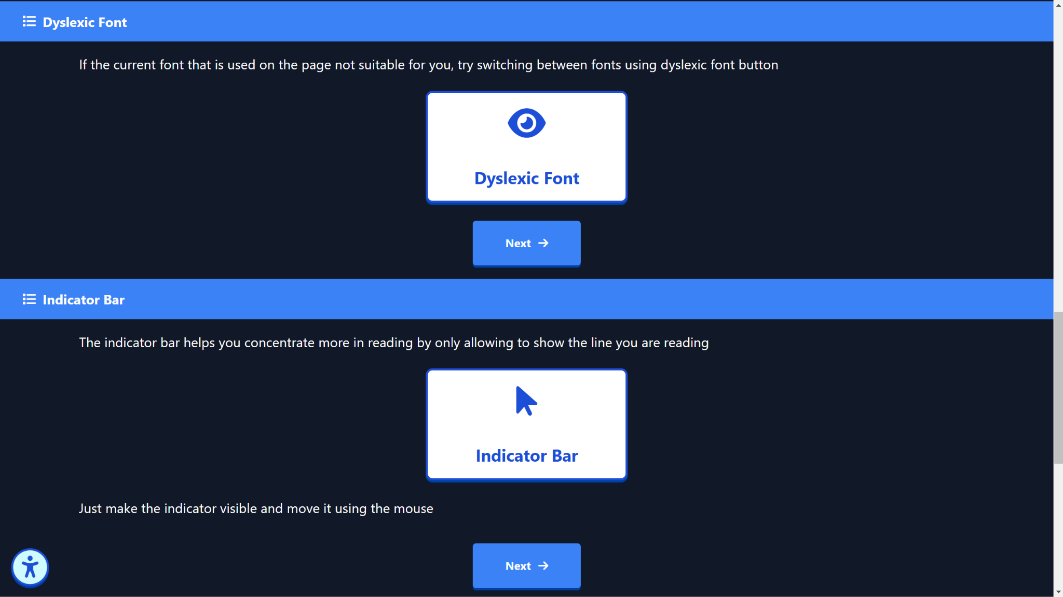

Slide 56
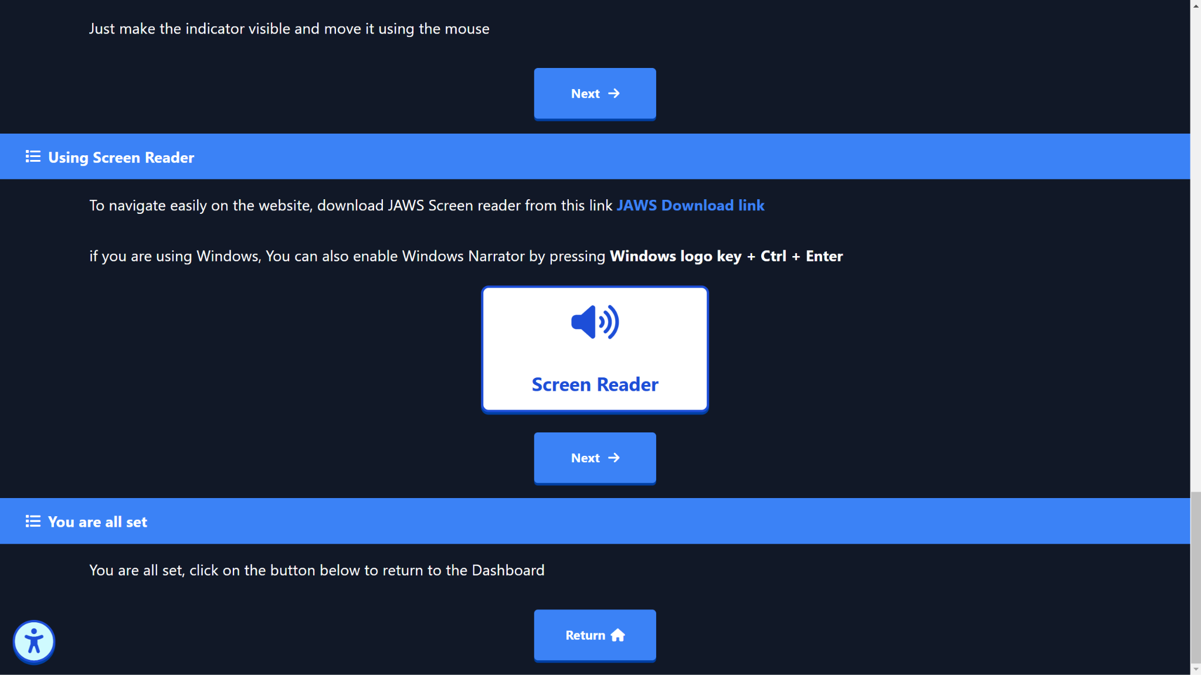

Slide 57
Academic Accommodation Plan to include
Receiving handouts and lecture presentations in advance.
Modifying course materials.
Class participation accommodation.
Assignment format, number of assignments, weight of assignments and deadlines.
Permission to make personal recordings of teaching sessions.
One to one session with tutors.
Online sessions.

Slide 58
Academic Accommodation Plan to include
Oral presentation accommodation.
Attendance policy.
Scribe or shadow teachers.
Access to private study rooms/ exam.
Adjustments for group work or presentations.
This may include presenting to a smaller audience or staff only, recording your presentation, or working in a smaller group or with people you know.

Slide 59
Academic Accommodation Plan to include
Scheduling support.
Offering some distance learning or self-study courses
Exam arrangements: private exam room, a support worker to assist (a reader, scribe or prompter ), etc.
Assistive technology sessions with our Assistive Technology Advisor (Text-to-speech/screen, magnification software, Fm system).

Slide 60
Policies & Legal Framework
Compliance with National Disability Laws: Ensuring adherence to all relevant legal requirements for accessibility and inclusion.
Inclusive Education Policies: Establishing policies that guarantee equal access to education for students with disabilities.

Slide 61
Policies & Legal Framework
Accommodation Procedures: Defining clear guidelines for requesting, evaluating, and implementing academic and campus accommodations.
Non-Discrimination Policy: Enforcing a zero-tolerance stance against discrimination based on disability to foster an inclusive and equitable environment.

Slide 62
Executive Summary
The establishment of an Inclusion Department at ESLSCA University represents a transformative commitment to an equitable and supportive learning environment for all students.
This department will ensure students with disabilities have comprehensive support, advocacy, and access to academic and extracurricular opportunities.
With this proposal, we present a plan outlining the vision, mission, structure, Policies and strategic approach to fostering inclusion, backed by resources, policies, and specific accommodations that will enable students to thrive.

Slide 63
Monitoring and Evaluation
Feedback Mechanism: Regular input from students on service effectiveness.
Annual Reporting: Departmental impact reports for continuous improvement.
Continuous Improvement: Policy updates based on research and student needs.
Inclusive Advisory Committee: Student representation to ensure relevant issue addressing.

Slide 64
Partnerships & Collaboration
Internal Collaboration: Cross-departmental collaboration for a unified support network.
External Partnerships: Engagement with disability organizations, agencies, and technology providers.
Employer Partnerships: Developing accessible internship and job pathways for students.

Slide 65
Budget & Resources
Initial Investment
Ongoing Costs
Funding Sources
costs for technology, staffing, and infrastructure.
Staffing salaries, technology updates, and continuous training.
Internal funding, government grants, and partnerships.

Slide 66
Budget & Resources
Assessment & Planning (3-6 months)
Conduct needs assessments, staff recruitment, and policy drafting
Infrastructure & Training (6 months)
Implement physical and digital accessibility, and train faculty and staff.
Full Launch: Fall 2025
Launch comprehensive support services, student plans, and monitoring processes.

Slide 67
Faculty Training & Development
Workshops: Mandatory training on inclusive teaching, disability awareness, and legal requirements.
Curriculum Adaptation: Guidance on creating accessible syllabi and assessment methods.
Technology Use: Training in assistive technology.
Crisis Management: Preparedness for handling disability-related emergencies.

Slide 68



